Slide 1
Husky Career Tech

Slide 2

Agenda
Executive summary
Objectives and Plan
Phase 1 Activities
Job Search Process Flow
Survey
Market Research
Social Media Outreach
Insights
Learnings and Recommendations
Summary
An inside look
Recommended plan overview

Slide 3
01
Executive Summary

Slide 4
Executive Summary
Continuous and intentional student engagement.
Target career materials & events to BAPM students.
Hire specialties to Husky Career Tech team.

Slide 5
02
Objectives and Plan

Slide 6
Objectives and Plan
Improve career services
Function as an extended arm to CDO
Building brand by working
Phase 1
Phase 2
Phase 3
Evaluate the current effectiveness of CDO Services
Prioritizing the problem areas
Designing solutions
Implementing the solutions
Identify Job Search Pain Points
Data Centric Approach | Customized Solutions

Slide 7
03
Phase 1
Jun - Aug

Slide 8
Job Search Process Flow
Networking
Resume/ Cover Letter Preparation
Job Application
Interviewing
Career Mapping
Follow-up
Map the job search journey
Understand the nuances/ pain points in each step
Instill a structure in the minds of the students

Slide 9
Survey
Gather qualitative and quantitative data about the career pain points
Criticality of problem areas
Customize solutions
Survey Snapshot
Audience
BAPM Students
(Both Current and Alumni)
Question areas
Demographic information,
Pain points in job search process, Feedback on CDO Services
Survey Responses
102
Current Students : 78 Alumni: 24

Slide 10
Market Research
Explore lesser known/ used tools
Comprehensive information guide
Career tools
Career Paths
Uncover findings from work experiences
Knowledge repository, shared with the student community

Slide 11





Social Media Outreach
Showcase the work and learnings from the project to UConn community
Build the brand of UConn among larger audience outside of UConn
Marketing Channels

Slide 12
03
Learnings &
Recommendations

Slide 13


Overall Insights and Goals
What’s currently going great?
Workshops, Company info sessions, 1:1 counselling, resume reviews
The gap?
Marketing
Events
Make CDO services more BAPM-targeted
Career Material

Slide 14
Event Categories
Mini Career Fairs (BAPM)
Harford campus
Competitions
Student led
Meetups
BAPM branding
Gamification
Alumni engagement
Data Science/Career
Cohesive feedback
Skill building
Location
Calendar
Cost
Notes:
From the survey results we identified that location and time are restricting students from attending various events like career fairs and competitions.
Almost all the career fairs happens in Storrs campus and BAPM students are not able to attend the career fairs because of schedule conflict or due to lack of transportation.
There were many case competitions and hackathons organised by various universities and companies in and around Hartford. But students are not able to participate in that because of the high cost involved.
Due to student’s Location, Calendar and Cost constraints, the following should be implemented:
Mini career fairs:
In UConn Hartford campus.
Competitions:
Students are more focused on building their skillset and hence it is necessary to organise various competitions like Hackathons and encourage students to participate in experiential learning, etc.
Incentives can be given to the students who participate in the competitions

Slide 15



Career Material | Workshops
BAPM specific workshop content
Industries
Possible career paths
Required skillsets
Certifications
( PMP/CAPM/SAS)
Pre and post workshop surveying to get immediate feedback
External workshops by BAPM alumni, MBA professors, industry experts
Notes:
Current workshop addresses most of the student pain points- career mapping, resume and cover letter, interviewing ,managing LinkedIn and job application.
We recommend BAPM specific workshop (talking about industries, possible career paths, skill sets required and about certfications like PMP, SAS and CAPM.
Have a pre and post workshop of survey( pre survey when the sign up for the workshop, post survey immediately after the survey)
Have external workshops( conducted by BAPM alumni, OPIM and MBA professors, industry experts)

Slide 16
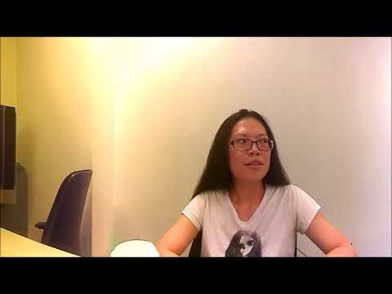
Career Material | Interview series
Informational Interviews
Why? Information about the realities of working within a particular field, industry or position
How? Conduct informational interviews with industry, alumni, recruiters
Train students to conduct such interviews themselves in mock sessions
Video Series – Career Happy Hour
Informational videos where the career advisor shares his recommendation and insights on various career development topics.
https://youtu.be/cZM4cRrgtN8?t=1m9s
Notes:
Part of internal strategy
Informational interview to gain insights about the career path , Get tips about how to prepare for and enter a given career, Gain insider knowledge that can help you in writing your resume, interviewing, and more. Meet people who may forward job leads to you in the future.
Who is part of this- Employers/ rectuiters/BAPM Alumni/ Career Advisors
Career Happy Hours-are informational videos where career advisor shares his recommendation and insights on various career development topics

Slide 17









Career Material | Market Research Guide
Study of Existing Career Tools
Tools for the Job Search Process
Career Mapping:
TechRepublic, TechCrunch, CB Insights
2. Resume/CL Preparation:
Vault, Husky Career Prep
3. Job Application:
Linkedin, Monster, Angellist
4. Interviewing:
Leetcode, Gainlo, Glassdoor
5. Networking:
Linkedin, Meetup
BAPM Career Paths
Technical Contributor
Data Scientist
Data Engineer
Data Management
Data Analyst
2. Business Contributor
Business Analysts
Business Intelligence
Marketing Analysts
3. Team Leader
Project Managers
Notes:
Career Path analysis
Technical Contributors, Business Contributors,- lists the job function, programming languages used and good to have skills
Industries- Banking, Insurance, Healthcare,Retail,Travel- ( list common business cases solved in each of the industries and desirable skills)
Comprehensive list of insights, resources and websites for each phase of the job search process

Slide 18
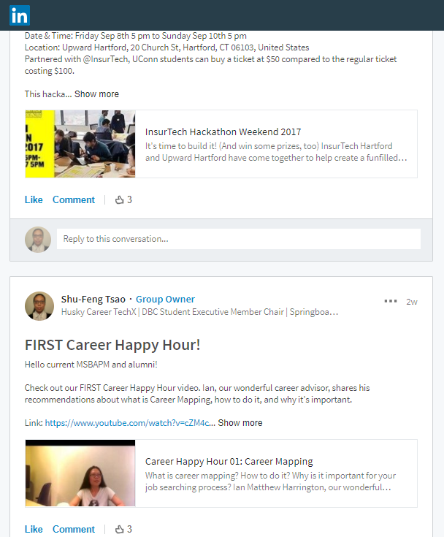
Marketing and Communication
Edit & publish existing content
Learning materials; recommended actions
Happy Hour videos, etc
Event marketing
Promoting videos pictures, infographics, etc
MSBAPM program marketing
Notes:
Career Path analysis
Technical Contributors, Business Contributors,- lists the job function, programming languages used and good to have skills
Industries- Banking, Insurance, Healthcare,Retail,Travel- ( list common business cases solved in each of the industries and desirable skills)
Comprehensive list of insights, resources and websites for each phase of the job search process

Slide 19
Recommended Plan Overview
Activity Types | Frequencies | Formats
MSBAPM Specific Career Fair | Spring, Fall | In-person, Online
Networking Events | Monthly | In-person, Online
Student-Led Meetups | Monthly from April to October | In-person
Competitions/Challenges | Bi-monthly | In-person, Online
Content Creation | Continuously | N/A
Student Engagement | Periodically | N/A
Notes:
Career Path analysis
Technical Contributors, Business Contributors,- lists the job function, programming languages used and good to have skills
Industries- Banking, Insurance, Healthcare,Retail,Travel- ( list common business cases solved in each of the industries and desirable skills)
Comprehensive list of insights, resources and websites for each phase of the job search process

Slide 20
Continued Engagement
Continually engage with BAPM students to identify their needs and address them by
Surveys
Informational Interviews
Focus Group Discussions
Problems Identified
(from survey)
LinkedIn Behavior
-Encourage continual Blogging
-Active Community Participation
-Alumni Groups
Career Mapping
-Doesn’t narrow down job options
Follow up on Applications
-Very few students follow up with recruiters on applications and interviews
Mock Interviews
-Work with CDO for more one on one interviews
Source: Survey results sent out by HCT team
Notes:
Speaker Notes :
HCT wants to continually get feedback from BAPM students to address their career needs. This is done by
Surveys , Informational Interviews and Focus Group Discussions
The problems we have identified from existing survey Include : ( It will be great if we have supporting slides in appendix to prove things were identified in survey)
Linkedin Behaviour:
Students view linkedin as a place to showcase projects and as a job portal. However Linkedin is more than that .Its a social network intended to improve Professional brand.
This is done by writing professional blogs, sharing thoughts in communities and networking with people who share similar thoughts. HCT encourages students to improve their linkedin activities through blogging assignments etc.
Career Mapping Perception Change-
There is a misconception among students that choosing roles that match their skills and specifically apply to them narrows their choices. However Applytng to jobs that does not match skills/experience only reduces their hit rates.
Follow up on applications
Mock interviews
Both are identified as needs of BAPM students. HCT intends to work with CDO to actively work on solutions.

Slide 21

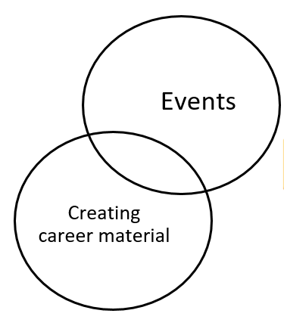
Insights from Husky Career Tech Phase 1
Formation of specialized student teams (2) to assist in managing key goals
Teams
BAPM workshops & Events
Marketing and Communication
Strategy & Operations
Career Advisors
Husky Career Tech
CDO +
Notes:
Student engagement is being partially fulfilled by career advisors
Nimble, agile teams that work together but are responsible for some set of goals

Slide 22
04
Appendix

Slide 23
Sample Job Descriptions
BAPM Workshop Series – Team member
Job Description: Should be able to suggest ideas and create workshop
Example topics – Storyboarding ; Project Management in Analytics ; Coding in Analytics ;
Work with MBA and BAPM faculty to curate content
Work with other teams in the creation of workshop content
Acts as a brand steward
Submit Pitch : Sample workshop
Marketing and Communication – Team member
Job Description: Should be able to design creative and effective advertising material, flyers, posters (Photoshop, InDesign, MS Publisher)
Should be able to edit videos
Manage social media accounts
Work with other teams in the creation of workshop content
Acts as a brand steward
Submit Pitch : Design a poster for a hackathon event at UCONN

Slide 24
Sample Job Descriptions
Career Strategy and Operations
– Team member
Job Description:
Strategizing with CDO and other sub teams
Process management
Data collection
Student segmentation
Survey evaluations
Acts as a brand steward
Submit Pitch : With the provided work breakdown structure and case details, act as a consultant and submit ideas to improve career

Slide 25
Greatly Appreciate Our Wonderful Team
Varnika Yertha
Sree Inturi
Jinwei Wang
Xueling Chen
Deeksha Ramesh
Pruthvi Nagaraju
Seemantini Chincholkar
Sriraman Krishnamurthy
Shu-Feng Tsao
Ian Matthew Harrington

